Slide 1
Module 5.2

Slide 2
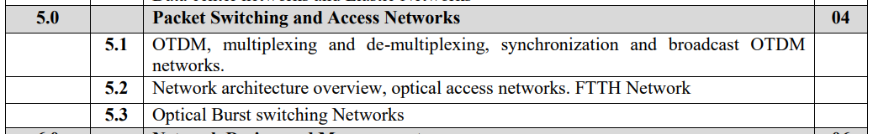

Slide 3
Access Networks
The access network is the telecommunications network that runs from the service provider’s facility to the home or business.
With fiber now directly available to many office buildings in metropolitan areas, networks based on SONET/SDH or Ethernet-based technologies are being used to provide high-speed access to large business users(consumers of data services).
Telephone and cable companies are also placing a significant emphasis on the development of networks that will allow them to provide a variety of services to individual homes and small to medium businesses.

Slide 4
Homes get essentially two types of services:
1. plain old telephone service (POTS) over the telephone network and
2. broadcast analog video over the cable network.
Recently added to this mix have been
3. data services for Internet access using either digital subscriber line (DSL)
technology over the telephone network or
4. cable modem service over the cable network.

Slide 5
Development of high-capacity access networks were devoted networks that would accommodate various forms of video, such as video-on-demand and
high-definition television.
However, the range of services that users are expected to demand in the future is vast and unpredictable.

Slide 16
Today, end users are interested in both
Internet access and other
high-speed data access services,
for such applications as
telecommuting,
distance learning,
entertainment video, and
videoconferencing.
Future, unforeseen applications are also sure to arise and make ever-increasing demands on the bandwidth available in the last mile.

Slide 17
At a broad level, these services can be classified based on three major criteria.
The first is the bandwidth requirement- which can vary from a few kilohertz for telephony to tens of megabits per second per video stream or even tens of gigabits per second for high-speed leased lines.
The second is whether this requirement is
-symmetric (two way), for example, videoconferencing, or
-asymmetric (one way), for example, broadcast video.
Today, while most business services are symmetric, other services tend to be asymmetric, with more bandwidth needed from the service provider to the user (the downstream direction) than from the user to the service provider (the upstream direction).
The last criterion is whether the service is inherently broadcast, where every user gets the same information, for example, broadcast video, or whether the service is switched, where different users get different information, as is the case with Internet access.
Here, You have to study different types of existing and emerging access network architectures.

Slide 18
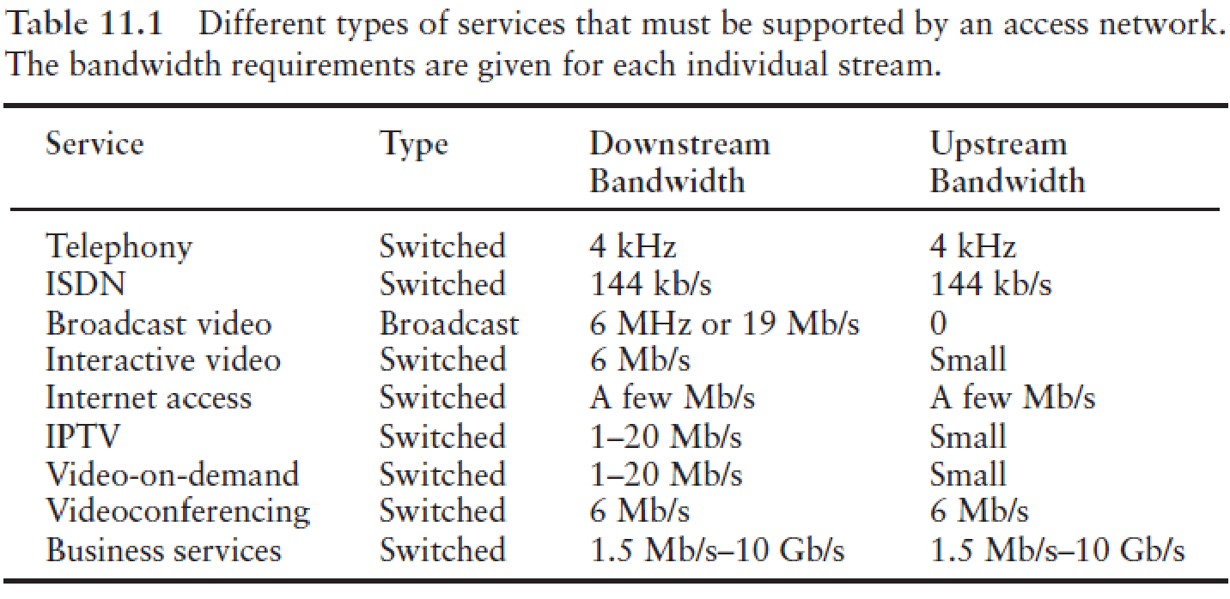

Slide 19
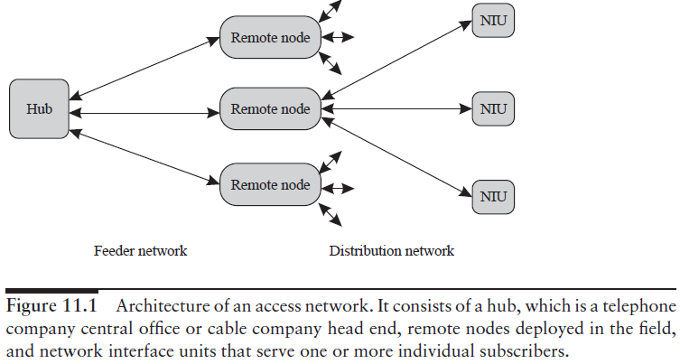
Network Architecture Overview

Slide 20
Network Architecture Overview
In broad terms, an access network consists of a hub, remote nodes (RNs), and network interface units (NIUs), as shown in Figure 11.1.
In the case of a telephone company, the hub is a central office (also called a local exchange in many parts of the world), and
In the case of a cable company, it is called a head end.
Each hub serves several homes or businesses via the NIUs.
An NIU either may be located in a subscriber location or may itself serve several subscribers.
The hub itself may be part of a larger network.
Hub acts as the source of data to the NIUs and the sink of data from the NIUs.
In many cases, rather than running cables from the hub to each individual NIU, another hierarchical level is introduced between the hub and the NIUs.
Each hub may be connected to several RNs deployed in the field, with each RN in turn serving a separate set of NIUs.
The network between the hub and the RN is called the feeder network, and the network between the RN and the NIUs is called the distribution network.

Slide 21
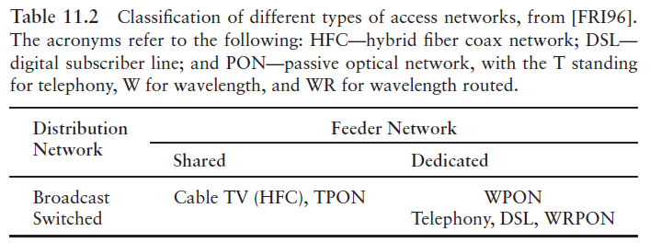
The telephone network is a switched network that provides dedicated bandwidth to each user.
The cable network is a broadcast network, with all NIUs sharing the total cable bandwidth.
A broadcast WDM passive optical network (WPON), with each NIU assigned a separate wavelength, is an example of a broadcast network but with dedicated bandwidth to each NIU.

Slide 22
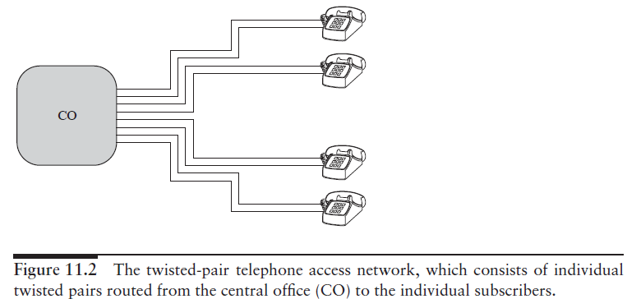
Today, two kinds of access networks reach our homes: the telephone network and the cable network.
The telephone network runs over twisted-pair copper cable.
It consists of point-to-point copper pairs between the telco central office and the individual home.

Slide 23
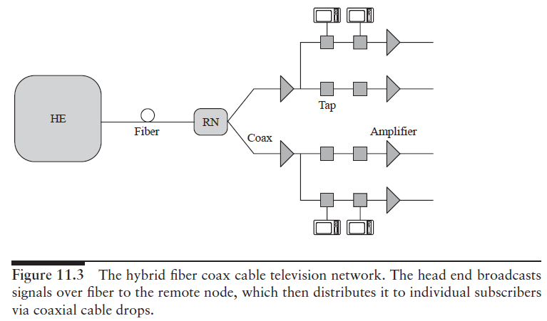
A typical cable network is shown in Figure 11.3.
It consists of fibers between the cable company head end (analogous to a telco central office) and remote (fiber)nodes.
Usually, the channels from the head end are broadcast to the remote nodes by using subcarrier multiplexing (SCM) on a laser.
From the remote node, coaxial cables go to each home.
A remote node serves between 500 and 2000 homes. Such a network is called a hybrid fiber coax (HFC) network.
The cable bandwidth used is between 50 and 550 MHz.

Slide 24
Future access networks
Several approaches have been used to upgrade the access network infrastructure.
The integrated services digital network (ISDN) provides 144 kb/s of bandwidth over the existing twisted-pair infrastructure.
The digital subscriber line (DSL) is another technique that provides significantly more bandwidth, of few megabits per second, than ISDN, which is sufficient to transmit compressed video.
This requires that the central office (CO) and the home each have a DSL modem.
ISDN and DSL can be classified as switched networks with dedicated bandwidth per NIU.

Slide 25
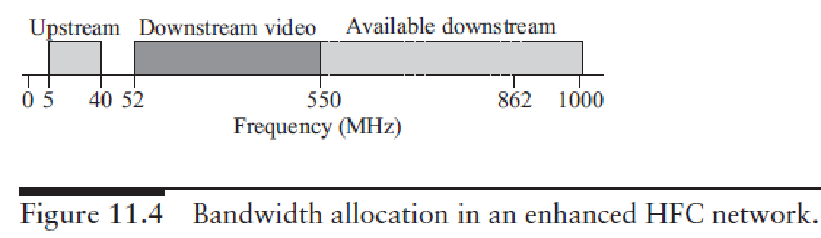
Enhanced HFC
An upgraded version of HFC architecture, is an enhanced HFC architecture.
Since both the fiber and the coax cable carry multiple subcarrier modulated streams, and it is a broadcast network, hence describe as subcarrier modulated fiber coax bus (SMFCB).
The network architecture is essentially the same as that shown in previous figure.
In order to provide increased bandwidth per user up to 1 GHz from the 500 MHz in conventional HFC systems, the network is being enhanced using a combination of several techniques.

Slide 26
Fiber to the x
In fiber to the curb (FTTC), data is transmitted digitally over optical fiber from the hub, or central office, to fiber-terminating nodes called optical network units (ONUs).
The expectation is that the fiber would get much closer to the subscriber with this architecture.
Depending on how close the fiber gets to an individual subscriber, different terms are employed to describe this architecture (see Figure 11.5).
Fiber to the home (FTTH)- Is the most optimistic scenario, fiber would go to each home. The ONUs would perform the function of the NIUs.
FTTC or fiber to the building (FTTB)- For the case where ONUs serve few homes or buildings, say, 8–64.
Typically, in FTTC, the fiber is within about 100 m of the end user.
In this case, there is an additional distribution network from the ONUs to the NIUs.
Fiber to the cabinet (FTTCab)- The fiber is terminated in a cabinet in the neighborhood and is within about 1 km of the end user.

Slide 27
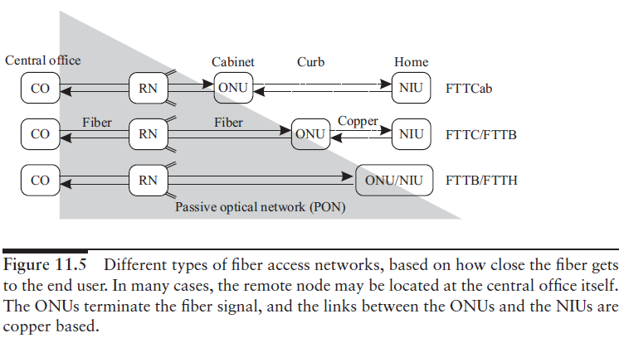

Slide 28
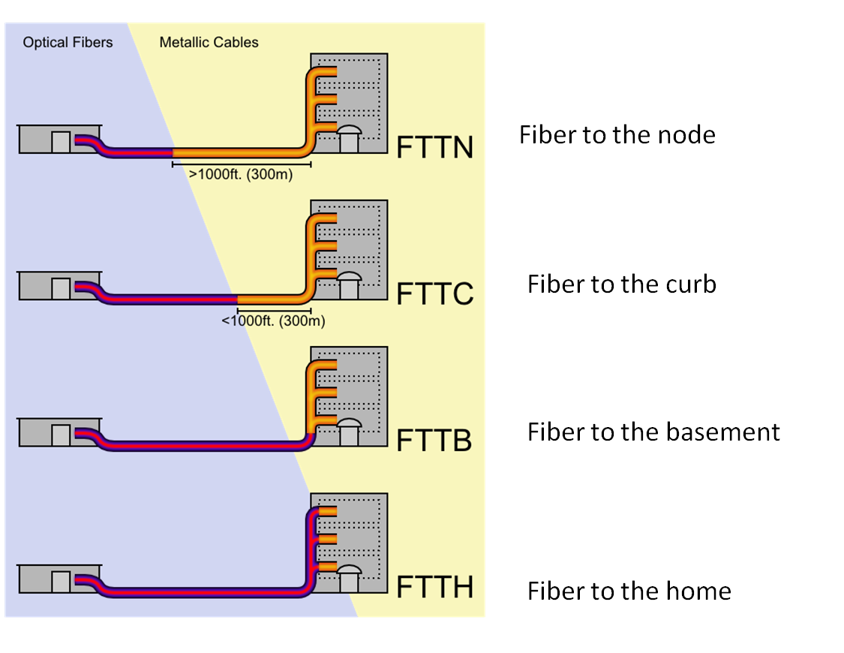

Slide 29
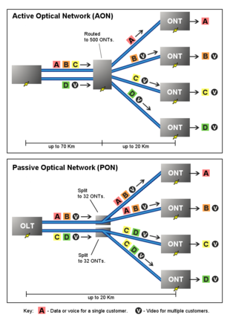
To make the FTTx architecture viable, the network from the CO to the ONU is typically a passive optical network (PON).

Slide 30
The International Telecommunications Union (ITU) standardized two generations of TPON.
The older ITU-T G.983 standard was based on Asynchronous Transfer Mode (ATM), and has therefore been referred to as APON (ATM PON).
Further improvements to the original APON standard –led to the full, final version of ITU-T G.983 being referred to more often as broadband PON, or BPON.
A typical APON/BPON provides 622 megabits per second (Mbit/s) (OC-12) of downstream bandwidth and 155 Mbit/s (OC-3) of upstream traffic, although the standard accommodates higher rates.

Slide 31
The ITU-T G.984 Gigabit-capable Passive Optical Networks (GPON) standard represented an increase, compared to BPON, in both the total bandwidth and bandwidth efficiency through the use of larger, variable-length packets.
Again, the standards permit several choices of bit rate, but the industry has converged on 2.488 gigabits per second (Gbit/s) of downstream bandwidth, and 1.244 Gbit/s of upstream bandwidth.

Slide 32
In 2004, the Ethernet PON (EPON or GEPON) standard 802.3ah-2004 was ratified as part of the Ethernet in the first mile project of the IEEE 802.3.
EPON is a "short haul" network using ethernet packets, fiber optic cables, and single protocol layer.
EPON also uses standard 802.3 Ethernet frames with symmetric 1 gigabit per second upstream and downstream rates.
EPON is applicable for data-centric networks, as well as full-service voice, data and video networks.
10G-EPON supports 10/1 Gbit/s.
The downstream wavelength plan support simultaneous operation of 10 Gbit/s on one wavelength and 1 Gbit/s on a separate wavelength for the operation of IEEE802.3 Ethernet.

Slide 33
One way of providing fiber to the home is through a Gigabit Passive Optical Network, or GPON.
GPON is a point-to-multipoint access network. Its main characteristic is the use of passive splitters in the fiber distribution network, enabling one single feeding fiber from the provider to serve multiple homes and small businesses.
GPON has a downstream capacity of 2.488 Gb/s and an upstream capacity of 1.244 Gbp/s that is shared among users.
Encryption is used to keep each user’s data secured and private from other users.
Although there are other technologies that could provide fiber to the home, passive optical networks (PONs) like GPON are generally considered the strongest candidate for widespread deployments.

Slide 34
The remote node is a simple passive device such as an optical star coupler, and it may sometimes be colocated in the central office itself rather than in the field.
Although many different architectural alternatives can be used for FTTC, the term FTTC is most often used to describe a version where the signals are broadcast from the central office to the ONUs, and
The ONUs share a common total bandwidth in time division multiplexed fashion.

Slide 35
The optical networks proposed for this application are commonly called PONs (passive optical networks)—all of them use passive architectures.
They use some form of passive component, such as
an optical star coupler or
a static wavelength router, as the remote node.
The main advantages of using passive architectures in this case come from their reliability, ease of maintenance, and the fact that the field-deployed network does not need to be powered.
Moreover, the fiber infrastructure itself is transparent to bit rates and modulation formats, and the overall network can be upgraded in the future without changing the infrastructure itself.

Slide 36
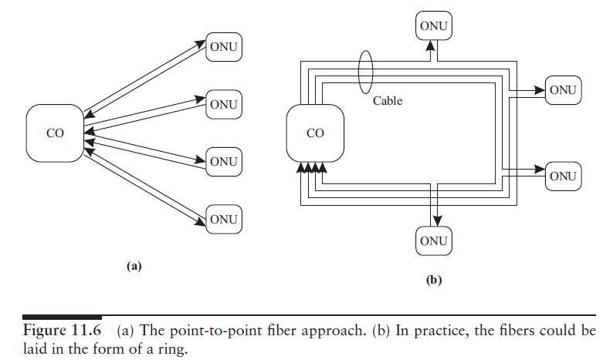

Slide 37
Instead of providing a fiber pair to each ONU, a single fiber can be used with bidirectional transmission.
However, the same wavelength cannot be used to transmit data simultaneously in both directions because of uncontrolled reflections in the fiber.
One way is to use time division multiplexing so that both ends do not transmit simultaneously.
Another is to use different wavelengths (1.3 and 1.55 μm, for example) for the different directions.

Slide 38
More commonly, rather than dedicating a fiber pair per user, the fiber pair is shared by many users.
The most common example of such networks are the SONET/SDH rings, which are now widely deployed to provide high-speed services to large business customers.
These rings operate at speeds ranging from 155 Mb/s to 10 Gb/s.
In this case, an ONU is a SONET add/drop multiplexer (ADM), and multiple ONUs can be present on the same ring.

Slide 39
PON architectures provide a more cost-effective solution for addressing the needs of small- and medium-sized businesses and homes, which require a few DS1 (1.5 Mb/s) lines, DSL lines, or 10 Mb/s Ethernet connections.

Slide 40
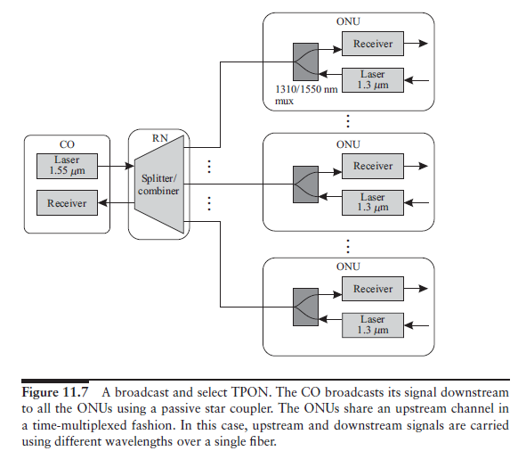
TPON

Slide 41
Common PON architecture is the TPON (originally called PON for telephony) architecture, shown in Figure 11.7.
The downstream traffic is broadcast by a transmitter at the CO to all the ONUs by a passive star coupler.
Although the architecture is a broadcast architecture, switched services can be supported by assigning specific time slots to individual ONUs based on their bandwidth demands.
For the upstream channel, the ONUs share a channel that is combined using a coupler, again via fixed time division multiplexing (TDM) some other multiaccess protocol.
In the TDM approach, the ONUs need to be synchronized to a common clock.
This is done by a process called ranging, where each ONU measures its delay from the CO and adjusts its clock such that all the ONUs are synchronized relative to the CO.
The CO then assigns time slots to each ONU as needed.

Slide 42
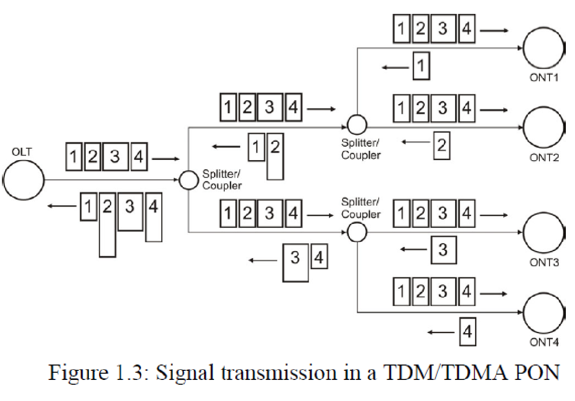

Slide 43
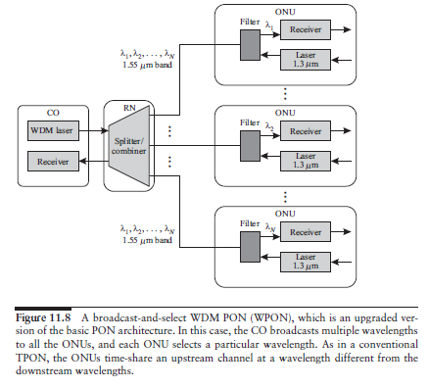
WPON

Slide 44
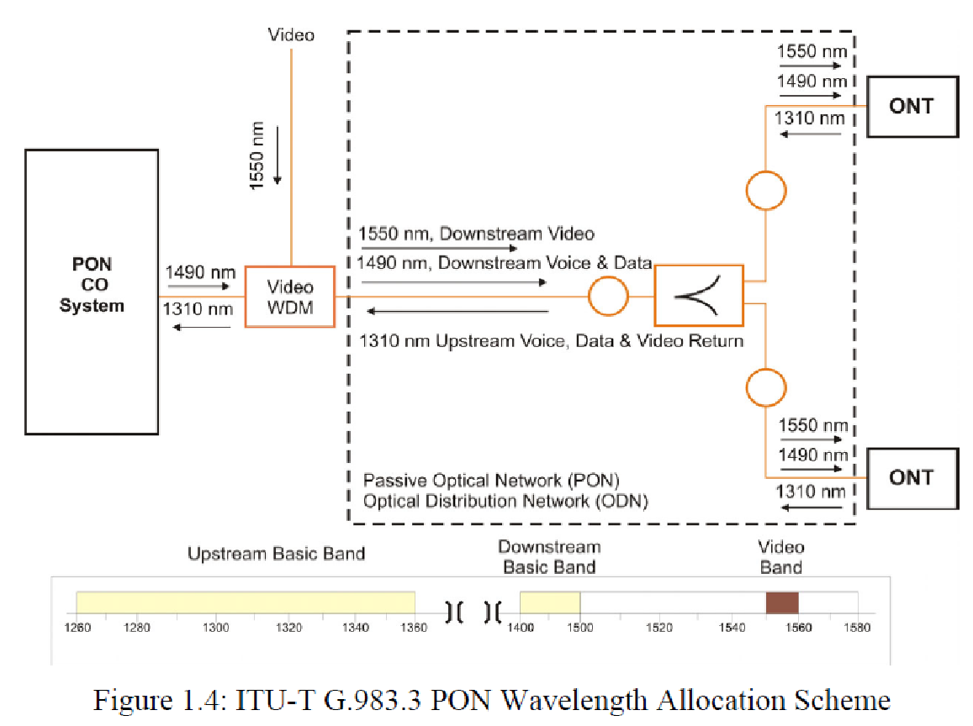

Slide 45
WDM technology can be applied to TPONs.
WDM can increase the capacity and flexibility of TPONs.
An architecture to implement WDM into a TPON is shown in Figure 11.8.
Single transceiver at the CO is replaced with a WDM array of transmitters or a single tunable transmitter to yield a WDM PON (WPON).
Each ONU is equipped with electronics, running only at the rate it receives data.
However, it is still limited by the power splitting at the star coupler.

Slide 46
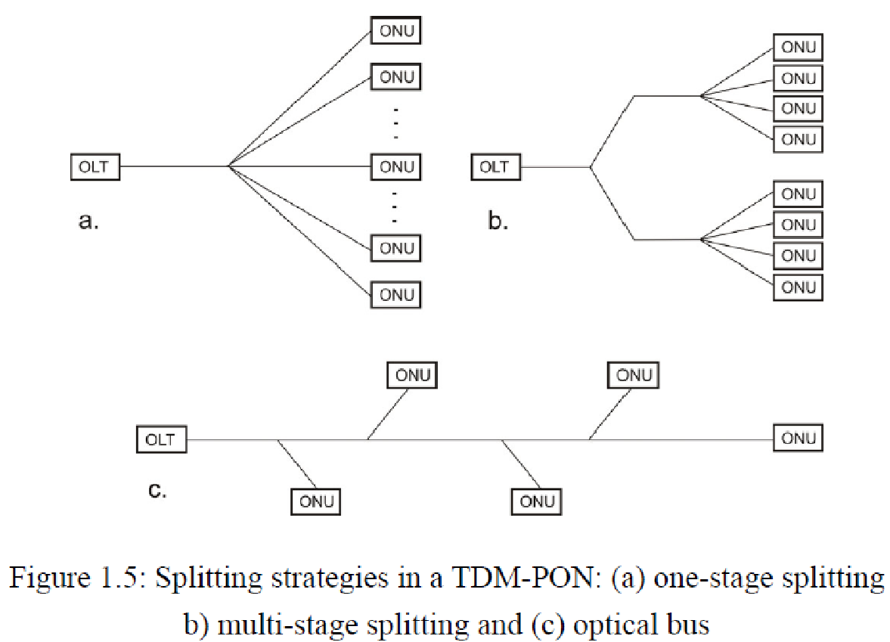

Slide 47
Most of the commercial PON systems have a splitting ratio of 1:16 or 1:32.
A higher splitting ratio means that the cost of the PON OLT is better shared among ONUs.
However, the splitting ratio directly affects the system power budget and transmission loss.
The ideal splitting loss for a 1:N splitter is 10*log(N) dB.
To support large splitting ratio, high power transmitters, high sensitivity receivers, and low-loss optical components are required.
Higher splitting ratio also means less power left for transmission fiber loss and smaller margin reserved for other system degradations and variations.
Therefore, up to a certain point, higher splitting ratio will create diminishing returns.

Slide 48
A high splitting ratio also means the OLT bandwidth is shared among more ONUs and will lead to less bandwidth per user.
To achieve a certain bit error rate (BER) performance, a minimum energy per bit is required to overcome the system noise.
Therefore, increasing the bit rate at the OLT will also increase the power (which is the product of bit rate and bit energy) required for transmission.
The transmission power is constrained by available laser technology (communication lasers normally have about 0–10 dBm output power) and safety requirements issued by regulatory authorities.

Slide 49
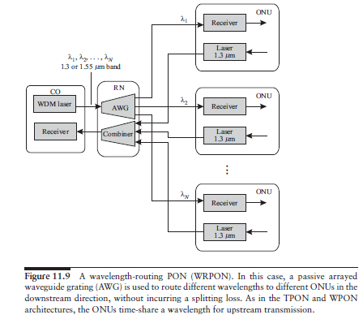
WRPON

Slide 50
Introducing wavelength routing solves the splitting loss problem while retaining all the other advantages of the WDM PON.
It allows point-to-point dedicated services to be provided to ONUs.
This leads to the WRPON architecture shown in Figure 11.9.
Several types of WRPONs have been proposed and demonstrated.
Uses a wavelength router, typically an arrayed waveguide grating (AWG) for the downstream traffic.
The router directs different wavelengths to different ONUs.

Slide 51
PON Evolution
There is an evolution path from a very simple TPON architecture to some of the more complex WRPON architectures.
The evolution can be performed with minimal disruption of existing services and without wasting already-deployed equipment.

Slide 52
The upgrade scenario for PONs could go as follows.
The operator can start by deploying a simple broadcast TPON, which is a broadcast star network with shared bandwidth.
If more ONUs need to be supported, the operator can upgrade the network to a WDM broadcast PON, which is a broadcast network with dedicated bandwidth provided to each ONU.
This can be done by upgrading the transmitters at the CO to WDM transmitters, and the operator may be able to reuse the existing ONUs.
If higher capacities per ONU are needed, the operator can further upgrade the network to a wavelength-routed PON, which is a switched network with dedicated bandwidth.
Thus there is an upgrade path starting from a broadcast network with shared bandwidth to a broadcast network with dedicated bandwidth and eventually to a switched network with dedicated bandwidth.

Slide 53
Fiber based last mile technology – FTTX

